Slide 1
SAFARI Montage
Advanced User Workshop
ISTE June 26, 2011

Slide 2
How you use technology in education is more important than if you use it at all.
Transformation = http://youtu.be/m10RYAkhuos
Notes:
From David Thornburg, “Technology in K-12 Education: The Envisioning a New Future.”
This is the global world we need to prepare our students to be successful within.
The effective use of technology in education requires thought, experimentation, and a willingness to spend the time needed to develop and refine strategies.

Slide 3
Workshop Goals
Learn about old and new teaching strategies
Understand how 21st century skills will foster student growth
Explore SAFARI Montage to support teaching and learning
Notes:
In this session we’ll learn about old and new teaching strategies to foster growth in 21st century skills and explore how SAFARI Montage can support this way of teaching and learning.

Slide 4
The Importance of Building Effective Playlists
To
differentiated instruction and Promote 21st century skills
How?
Communicate the topic with user-uploaded content,
build a playlist that invites collaboration and critical thinking,
and create a project that gets uploaded and presented in the system.
Create a “4Cs” graphic

Slide 5
Using http://www.wallwisher.com/wall/SAFARIWorkshop3:
Post two ways that a teacher could help a student learn better by taking their learning style into account.
Take a moment to read each other’s posts.
Take this survey: What is your preferred learning style?
http://literacyworks.org/mi/assessment/findyourstrengths.html
Notes:
Before you can truly differentiate in your classrooms you need to know the learning styles of your students. What are the strengths that your kids bring to the table? There are many free online surveys that focus on learning styles or even Howard Gardner’s multiple intelligences. I’d like us to take a moment to find out how we learn best. Once you have discovered your learning style think about you as a student in your class. How are you going to teach a student that learns like you? Post a note on the Wallwisher page.

Slide 6
Differentiated Instruction
Do you know your learning style?
Do you know the learning styles of your students?
Do you know what your students are interested in?
Do you know what background knowledge students come to your class with?
Three Ways to Differentiate:
Interest
Prior knowledge
Learning style
Three Ways to Instruct with DI:
Tiered assignments
Choice Menus
RAFT strategy
Notes:
DI is based on the fact that in a typical classroom, students vary in their academic abilities, learning styles, personalities, interests, background knowledge and experiences, and levels of motivation for learning. When a teacher differentiates instruction, he or she uses the best teaching practices and strategies to create different pathways that respond to the needs of diverse learners.
In order to differentiate we need to tap into student interest, prior knowledge, and their learning styles. I’m going to show you three instructional strategies you can use in your classroom to help you differentiate. After we investigate the strategies we’ll then explore how SAFARI Montage digital content and systems can help us to create differentiated, 21st century skill-based lessons supported with playlists. So let’s look at Tiered Assignments.
SAFARI Montage content can help to differentiate by using specific video clips that align directly to level of interest, learning styles, and prior knowledge. Teachers can create multiple playlists through the copy function and then modify the content to meet the individual or group needs of their classroom students.

Slide 7
Tiered Assignments
Tiered assignments should be:
-Different work, not simply more or less work
-Equally active
-Equally interesting and engaging
-Fair in terms of work expectations and time needed
-Requiring the use of key concepts, skills, or ideas
Tier by:
Challenge level (Bloom’s)
Complexity
Resources
Outcome
Process
Product
http://daretodifferentiate.wikispaces.com/Tiering
http://www.centralischool.ca/~bestpractice/tiered/examples.html
Notes:
Tiered assignments (slide and handout)
The premise behind tiered assignments is that students work at varied degrees of difficulty on their tasks, they explore all the same essential ideas but work at different levels of thought. Groups eventually come together to share and learn from each other.

Slide 8
Choice Menus
Wouldn’t you rather choose to do something then be told to do it?
Students can:
Recognize their strengths
Create to their vision
Focus their learning
Increase their engagement
http://daretodifferentiate.wikispaces.com/Choice+Boards
Notes:
One way to tier assignments is to use Choice Menus (slide and handout). Choice menus are designed to let students choose an activity (or activities) they would like to complete that shows their mastery of the content.

Slide 9
RAFT Strategy (Role, Audience, Format, Topic)
Encourages creative thinking
Motivates students to demonstrate understanding
Fosters processing of information
The student has a role to play and as they think in that role, they have to talk to a given audience using the format noted on the topic listed.
R: Semicolon
A: Middle School students
F: Diary Entry
T: I Wish You Really Understood Where I Belong!
R: Rain Drop
A: Future Droplets
F: Advice Column
T: The Beauty Of Cycles
http://daretodifferentiate.wikispaces.com/R.A.F.T.+Assignments
Notes:
RAFT (slide and handout) encourages creative thinking and motivates students to demonstrate understanding in a nontraditional yet informational written format. The student has a role to play and as they think in that role, they have to talk to a given audience using the format noted on the topic listed. This strategy forces students to process information rather than just write answers to questions. Here a couple examples.
I am a semi colon and I need to explain to, let’s say, on a 7th grade level, how I should be used. I have to explain this in a diary entry. I know from prior knowledge that diaries are used to journal about experiences and observations, so I will probably write my entry as if I was sad or frustrated that people just don’t understand how to use me right.

Slide 10
R: Semicolon
Point of view is clear
A: Middle School students
Language is leveled
F: Diary Entry
Writing style is personal
T: I Wish You Really Understood Where I Belong!
Shows understanding by definition and example, and explains what a SC is not
Oh, woe is me. I just don’t understand why I can’t be used correctly in a sentence. It really hurts my feelings when people leave me out or put me in the wrong place. COME ONE! How hard can it be to separate two independent clauses that aren’t hanging out with a conjunction? It’s like kids today are lazy; they just don’t get it.
You know what really makes me mad though? Is when a colon is used instead of me!! We’re so different but we get confused with each other all the time. I mean, hey, I like a colon, but it’s not me!!
Notes:
ASK: Who would like to read the diary entry? Drama! [point out how the writing sample met the RAFT requirements]

Slide 11
Dear Weathergirl:
I am a rain drop and am so worried about the future, of not only myself, but all the other raindrops in the world. Since our planet is getting warmer and warmer, and I know that heat dries me up, what’s to become of my friends and I?
Signed, Almost Gone
Dear Almost Gone:
You realize that even if our planet continues to get warmer it will be many, many years before there would be no water left. Live for today! There is beauty in that you get to live your life over and over again in the rain cycle. Not many get that opportunity. Think of the places you have yet to visit? Be excited instead of sad.
Signed, Weathergirl
R: Rain Drop
Point of view is clear
A: Future Droplets
Worried about other droplets
F: Advice Column
Writing style is personal and asking for advice
T: The Beauty Of Cycles
Shows understanding by using concepts of global warming, evaporation, and rain cycle.
Notes:
Here is another example for science.
We’ll come back to this in more depth later, but quickly here is how SAFARI Montage and the digital content found can support these two concepts. [show the following playlists]
Punctuation: Semi Colon
Water Cycle and Effects of Global Warming
SAFARI Montage content can help to differentiate by using specific video clips that align directly to level of interest, learning styles, and prior knowledge. Teachers can create multiple playlists through the copy function and then modify the content to meet the individual or group needs of their classroom students.

Slide 12
21st Century Skills
Quote from Paul Valery, French critic and poet (1871-1945)
“The trouble with our times is that THE FUTURE is not what it used to be.”
Notes:
The digital world is changing the way kids think, communicate, and collaborate. We live in a 24/7/365 world where today’s students are sophisticated thinkers who are incredibly bored by most of today’s instruction.

Slide 13
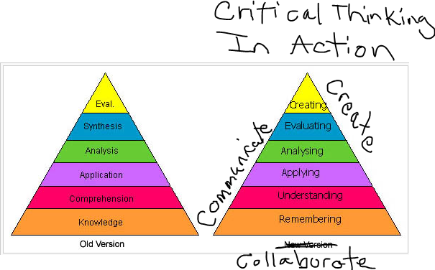
Create this image
Stop and Jot
What new skills must be considered as part of the basic literacy skills of any student?
Turn and Talk
Turn to your table neighbor and discuss your reflection.
Notes:
Bloom’s taxonomy was updated in the 1990s to make it more relevant to 21st century work. This kind of thinking is required for problem-solving, information processing, and idea creation.

Slide 14
http://youtu.be/KXZxYdg0IE4
Move Off the Stage!
Create image for data in notes
http://youtu.be/KXZxYdg0IE4
Notes:
Move off the stage
It’s getting harder to be the expert – the world produced five billion GB of digital information in 2003 (a stack of books reaching one third of the way from earth to the sun). Since 2007, the digital universe = 500 exabytes, or 500 billion GB of data (Ganz & Reinsel, 2009).

Slide 15
http://youtu.be/KXZxYdg0IE4
Move Off the Stage!
Create and insert the Learning Cone image
Teachers Must:
Move off the stage
Let students access information natively
Let students collaborate
Teach students visually
Re-evaluate instruction
Notes:
Move off the stage
Talking at students just doesn’t work (never did). Sitting quietly and listening to the teacher is the least effective way to learn, but this type of teaching continues today (Dale, 1956).
You may have seen this graphic with percentages attached. These numbers were added by William Glaser in 1998 in his book, The Quality School. While there may be debate over the numbers the idea is consistent: Learning increases when students become more active in the learning process.

Slide 16
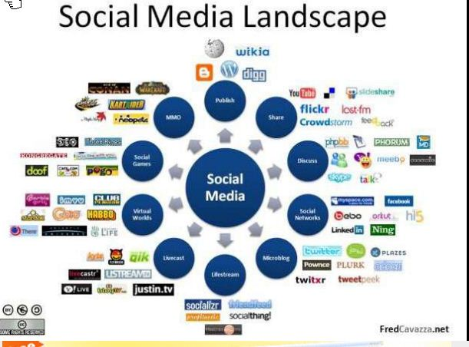
Access Information Natively
http://youtu.be/THWyMNsm1SY
http://youtu.be/ESMwyVxapck
Notes:
Let students access information natively
Students today have grown up in a digital world and they can use digital tools and strategies that may seem foreign to non-digital natives. They become frustrated when teachers don’t understand the importance of these tools in their lives and when the tools and strategies are not used in learning.
Show youtube video of commercial about lost dog, ATT: Lost dog no offer and Spelling Bee (ShareATT Youtube channel). Information is transmitted faster than before. The Internet has blown open the door to learning.

Slide 17
http://youtu.be/obCHKPYHuhA
Collaborate
Create image of students collaborating online
http://youtu.be/obCHKPYHuhA
Skills needed:
communicate with an online partner,
exchange files with that person,
do simultaneous collaborative work using tools that allow two or more people to work on a file together,
produce real digital work ,
negotiate distribution of work, resolve conflicts,
technical skills of multiple applications.
Notes:
Working on projects doesn’t have to be confined to classroom walls any more. Students can collaborate with each other via web-tools and digital devices easily. Collaboration in the workforce is the key to productivity.
http://youtu.be/obCHKPYHuhA
Skills needed: communicate with an online partner, exchange files with that person, do simultaneous collaborative work using tools that allow two or more people to work on a file together, produce real digital work , negotiate distribution of work, resolve conflicts, technical skills of multiple applications.

Slide 18
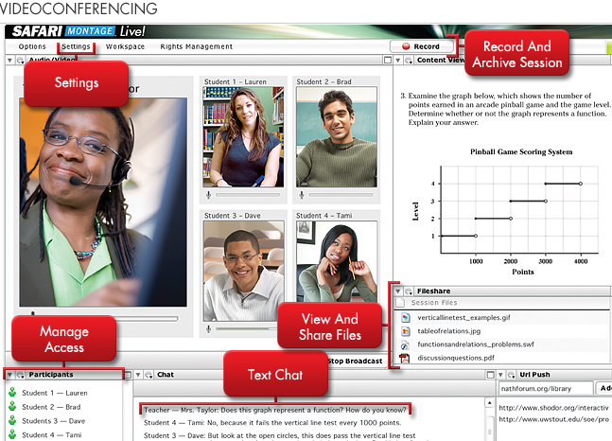
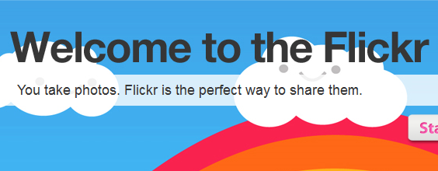
Collaborate: Tools to Use
http://cooltoolsforschools.wikispaces.com/Collaborative+Tools
Notes:
Here is just a small sample of digital tools to use: Of course SAFARI Montage has a videoconferencing module called SAFARI Montage Live!. Other tools can be found in web 2.0 on the Internet.
Image from http://www.crosscollaborate.com/2009/05/realtime-virtual-collaboration-conference/

Slide 19
Collaborate: Local and Global
Notes:
Begin with in-class work with partner or small groups, continue work outside of school virtually. Find other students outside school (across town, state, country) to work with.
Sites: ePals, Telecollaborate, Global SchoolNet, The Global Education Collaborative
CollaborizeClassroom Complement classroom instruction and engage students in online activities, assignments and discussions that allow for deeper participation inside and outside the classroom. Embed Microsoft Office documents, videos, pictures, and PDFs. Publish discussions to a results page so students can see tangible outcomes of their conversations. Download FREE lesson plans.
ePals http://www.epals.com/
ePals is the leading provider of safe collaborative technology for schools to connect and learn in a protected, project-based learning network. With classrooms in 200 countries and territories, ePals makes it easy to connect learners locally, nationally or internationally.
Tellecollaborate http://nschubert.home.mchsi.com/
Find projects, host projects, use digital collaborative tools
Global School Net http://www.globalschoolnet.org/
Global SchoolNet's mission is to support 21st century learning and improve academic performance through content driven collaboration.
Global Education Collaborative http://globaleducation.ning.com/

Slide 20
Visual Learning
Graphic needed: TV➔ Still Camera➔ Video Camera ➔WWW➔ Smartphones
Notes:
Communication has gone visual. It started with the advent of the television in the 50s and 60s, then the emergence of the still camera (black and white to color to digital). The video camera in the 80s changed the way people could archive their world and playback on the television. In the 90s and 20s the ability to send the video to the computer for editing made it possible for the average person to create professional quality movies. With the advent of the WWW in the mid 90s and its visual interface with color, icons, and photos, the words became read as images. The WWW also allowed for the distribution of all forms of visual communication. Then came the Smartphone which put all the history of visual communication into a device you could carry in the palm of your hand and you could distribute your creations with immediacy via wireless connections.
In the classroom teachers can use shapes, color, illustrations, and video content to convey new meaning to students. Visual communication can convey the same concept in a shorter amount of time. Today’s students have learned new skills that let them process visual information much more effectively than text in a highly interactive environment that they control.

Slide 21
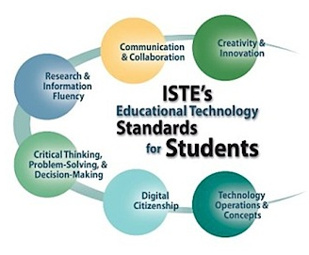
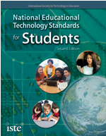
Re-evaluate instruction
Notes:
The world has changed. The kids have changed. The knowledge and skills needed to be successful in the world have changed. This means instruction should change. And if we want to change instruction we need to change assessment and how we evaluate learning.
The National Education Technology Plan specifies that the most effective way to evaluate what students know is through real-world applications. Building authentic assessments aligned to NET standards can help teachers learn how best to evaluate student’s understanding of 21st century skills and processes.

Slide 22
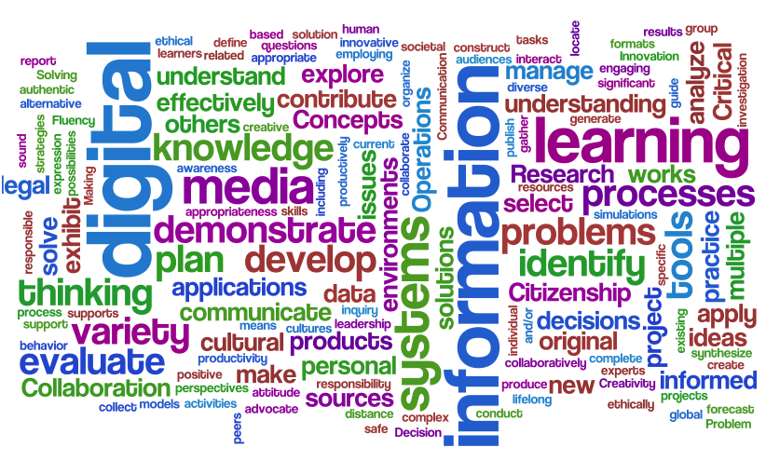
Notes:
Ask:
How can you harness the power of SAFARI to foster active learning through differentiation and teach 21st skills?

Slide 23
Using Video in the Classroom
Tell me and I’ll forget
Show me and I may remember
Involve me and I’ll understand
~ Chinese proverb
Notes:
Create/Insert Prensky graphic on to slide
According to Prensky (2006)
By the age of 21 most kids will have:
Played more than 10,000 hours of video games
Sent and received 250,000 emails, text, and instant messages
Spent 10,000 hours talking on the phone
Watched more than 20,000 hours of TV
Watched more than 500,000 commercials

Slide 24
Stop and Jot
How do you use SAFARI Montage to enhance instruction? Engage students?
Turn and Talk
Turn to your table neighbor and discuss your reflection.
Differentiate
Critically Think
Create
Communicate
Collaborate
Notes:
The digital content found in SAFARI Montage and from what you can upload through CreationStation will help you to enhance your instruction to support differentiated instruction and 21st century skills.
Collaborate – involve more than working with a partner or group IN the classroom; students need to work with someone outside the classroom; be able to communicate with an online partner, exchange files, use online tools for real-time work; can start in class and continue out of class, but should include students from other schools across the world; should produce real work with digital projects (web publishing, web journaling with blogs, video production, contribute to wiki, create a podcast). [could probably use information here from Shannon Miller]
Communicate – the world of communication has gone visual: tv, camera, video camera; WWW with colors, icons, and photos became as important as words; instant contact with Web, email, cell phones, etc has created an environment where things happen more quickly than ever before because we KNOW it is or has happened.
Create and Innovate – being creative extends beyond visual creative skills. It means using your imagination, thinking outside the box, coming up with solutions that haven’t been thought of before, trying something new and learning from the mistakes.

Slide 25
SAFARI Montage CreationStation
Upload user created content to SAFARI Montage
Add descriptive metadata
Enhances searchability within the system
Goal:
Learn about Creation Station
Outcome:
Build a playlist for the purpose of an authentic assessment that promotes the 4C skills through differentiation.
Notes:
So we have reached part 2 of our workshop where we will learn about CreationStation and upload user created content into SAFARI Montage to build more effective playlists.
Creation Station is a software module licensed by your school which allows for the upload and management of digital content, such as video, documents, interactive whiteboard files, or web links. Content can be shared to a school or when used in conjunction with WAN manager, published to the district. This digital content is then integrated into SAFARI Montage and becomes fully searchable. Content, once uploaded, can be meta-tagged with grade ranges, descriptions, correlated to state standards, and designated for home access.
CreationStation can be accessed from the logo on the SAFARI Montage Dashboard page. This brings the user to the CreationStation media upload page.

Slide 26
Advantages
Support a teachable moment
Illustrate how something works
Provide detailed information that text and images cannot
Grab attention
Show real life examples
Stimulate discussion
Appeals to visual learning styles
Enhance problem-based learning
Foster Higher Order Thinking
Predicting
Inferring
Comparing and Contrasting
Comprehending
Many more…
Notes:
Remember that SAFARI Montage has many instructional advantages and using video content fosters higher order thinking skills.

Slide 27
Playlist
A Playlist is simply a list of media titles or segments that have a related curriculum theme or objective.
Playlists may contain media titles, specific chapters within media titles, key concepts within chapters, images, PowerPoint and text documents as well as personal bookmarked segments and notes.
You can provide descriptive information about your playlist to help you recall why you created it.
Purposes of a Playlist
Idea – Introduction
Lesson - Differentiated Instruction
Resource – Review or Remediation
Independent Student Work
Substitute Teacher Resource
Professional Development
Best Practices
Notes:
Let’s just refresh and review about building basic playlists in SAFARI Montage.
Talk about effective playlists, purposing one of which can be to differentiate, and how using video fosters skills.
SAFARI Montage has a module that allows for both teacher and student creativity to shine.
Move into Creation Station demo

Slide 28
CreationStation Teacher User Types
Teacher – can upload IWB files
Teacher with upload – can upload all supported file types
Need two graphics – teacher in front of a white board and teacher in front of a computer

Slide 29
CreationStation File Formats
Whiteboard File Formats
.flp, .flipchart – Promethean
.as3a - Promethean Resource Pack
.xbk, .notebook - SMART Notebooks
.yar – Hitachi StarBoard
.gwb – eInstruction Workspace

Slide 30
Practice Exercise #6
What is the purpose of CreationStation?
How many formats does CreationStation support?
Why is it important to include metadata with each file upload?
What SAFARI Montage user types can upload content to CreationStation?
How can content be approved when published to the district?

Slide 31
Playlist
A Playlist is simply a list of media titles or segments that have a related curriculum theme or objective.
Playlists may contain media titles, specific chapters within media titles, key concepts within chapters, images, PowerPoint and text documents as well as personal bookmarked segments and notes.
You can provide descriptive information about your playlist to help you recall why you created it.
Purposes of a Playlist
Idea – Introduction
Lesson - Differentiated Instruction
Resource – Review or Remediation
Independent Student Work
Substitute Teacher Resource
Professional Development
Best Practices
Notes:
Talk about effective playlists, purposing one of which can be to differentiate, and how using video fosters skills.
SAFARI Montage has a module that allows for both teacher and student creativity to shine.
Move into Creation Station demo

